Slide 1
Chapter 6:
Bandwidth Utilization: Multiplexing and Spectrum Spreading

Slide 2
Revision

Slide 3
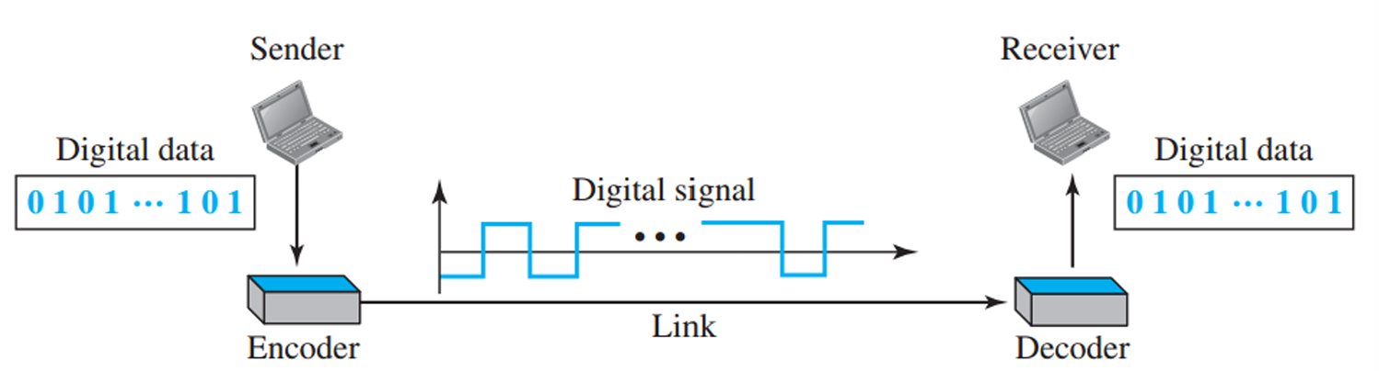
Line Coding
Line coding converts digital data to digital signals.

Slide 4
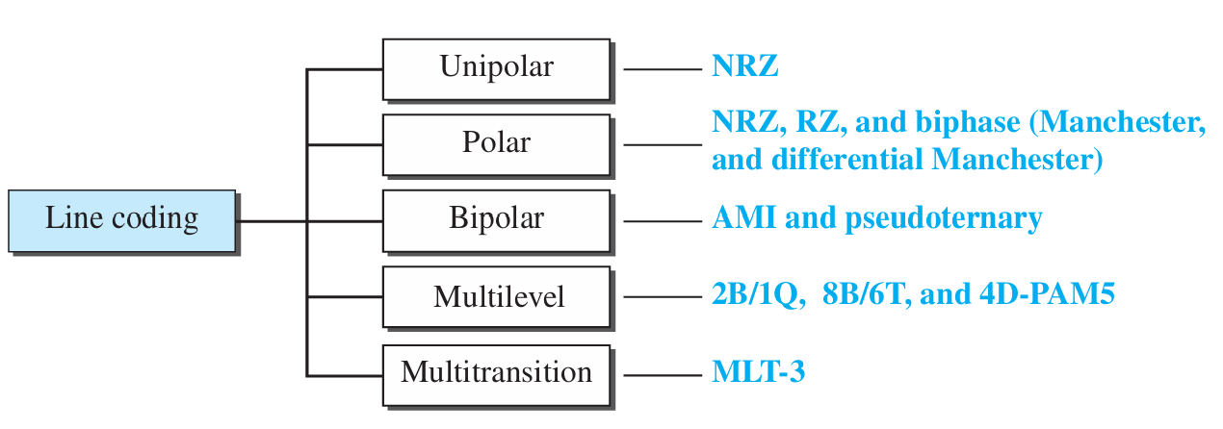
Line Coding Schemes
Notes:
M 18 38 H 13

Slide 5
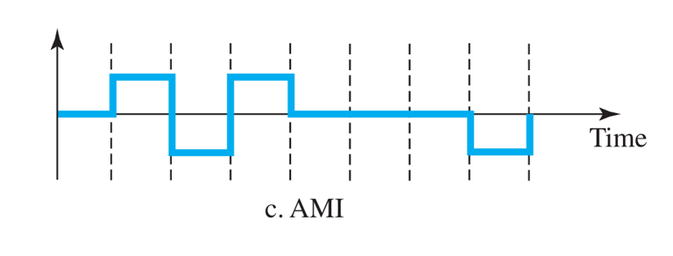
Find the 8-bit data stream for each case depicted in Figure 4.36.

Slide 6
Find the 8-bit data stream for each case depicted in Figure 4.36.
01110001

Slide 7
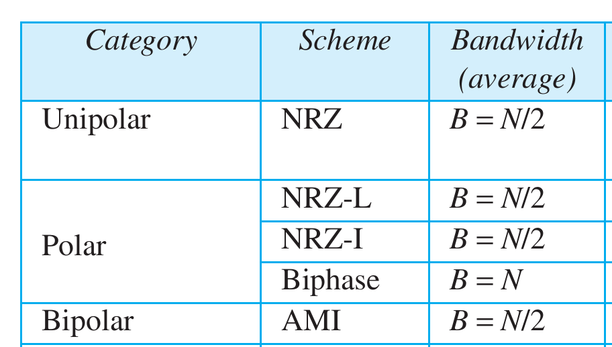

Slide 8
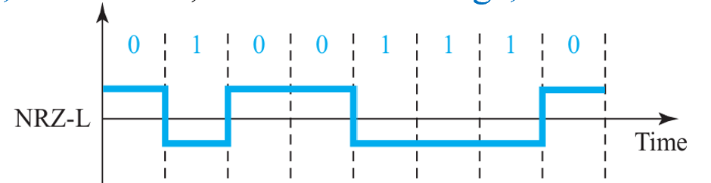
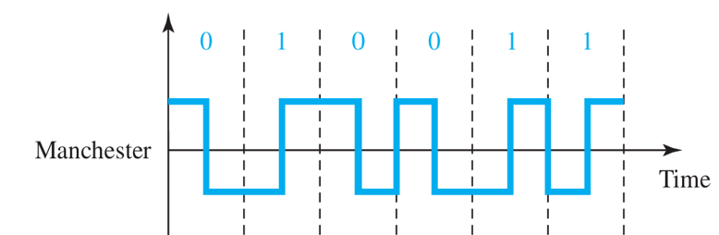
We have a baseband channel with a 1-MHz bandwidth. What is the data rate for this channel if we use each of the following line coding schemes?
a. NRZ-L
b. Manchester

Slide 9
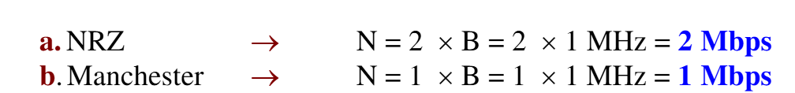
Solution

Slide 10
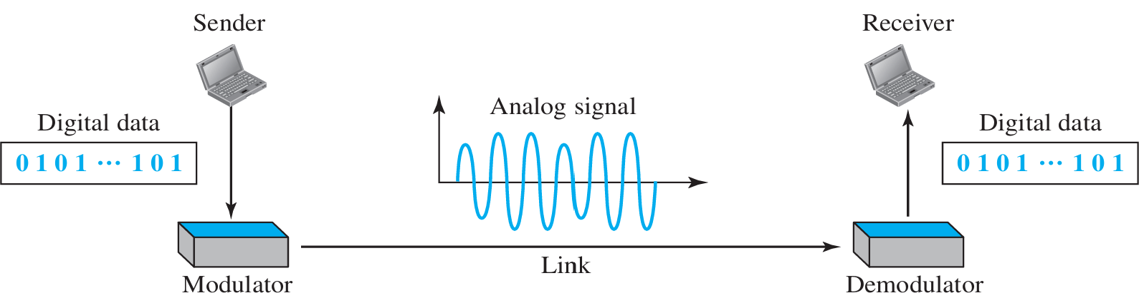
DIGITAL-TO-ANALOG CONVERSION
Digital-to-analog conversion is the process of changing one of the characteristics of an analog signal based on the information in digital data.

Slide 11
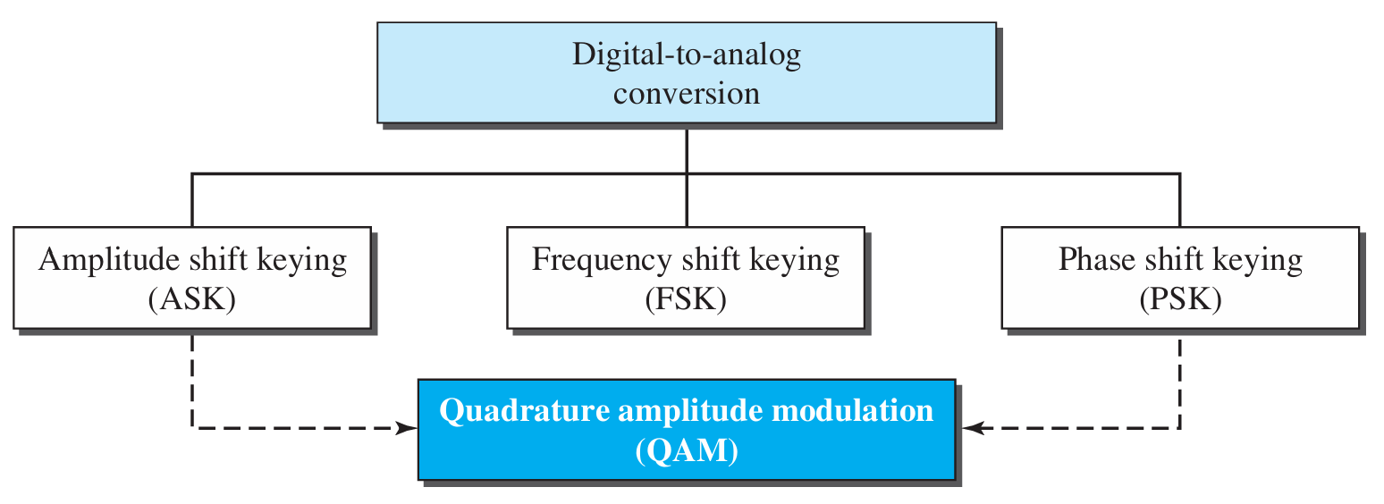
Types of digital-to-analog conversion

Slide 12
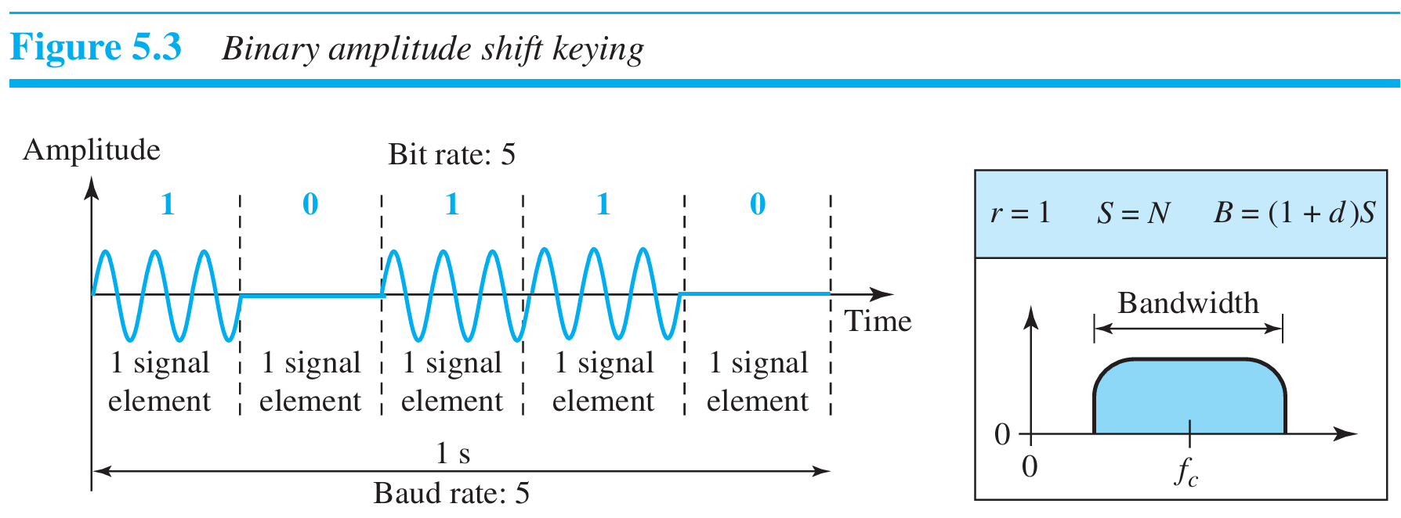
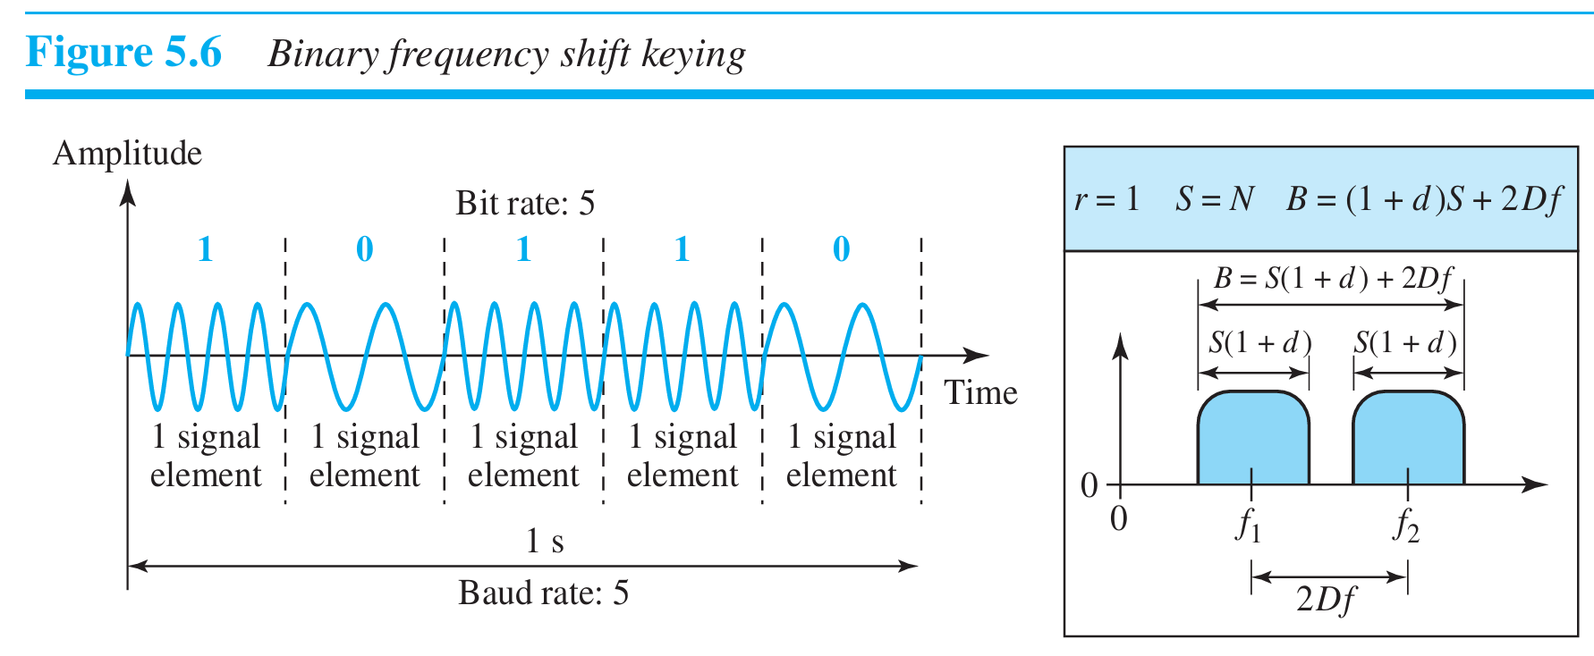
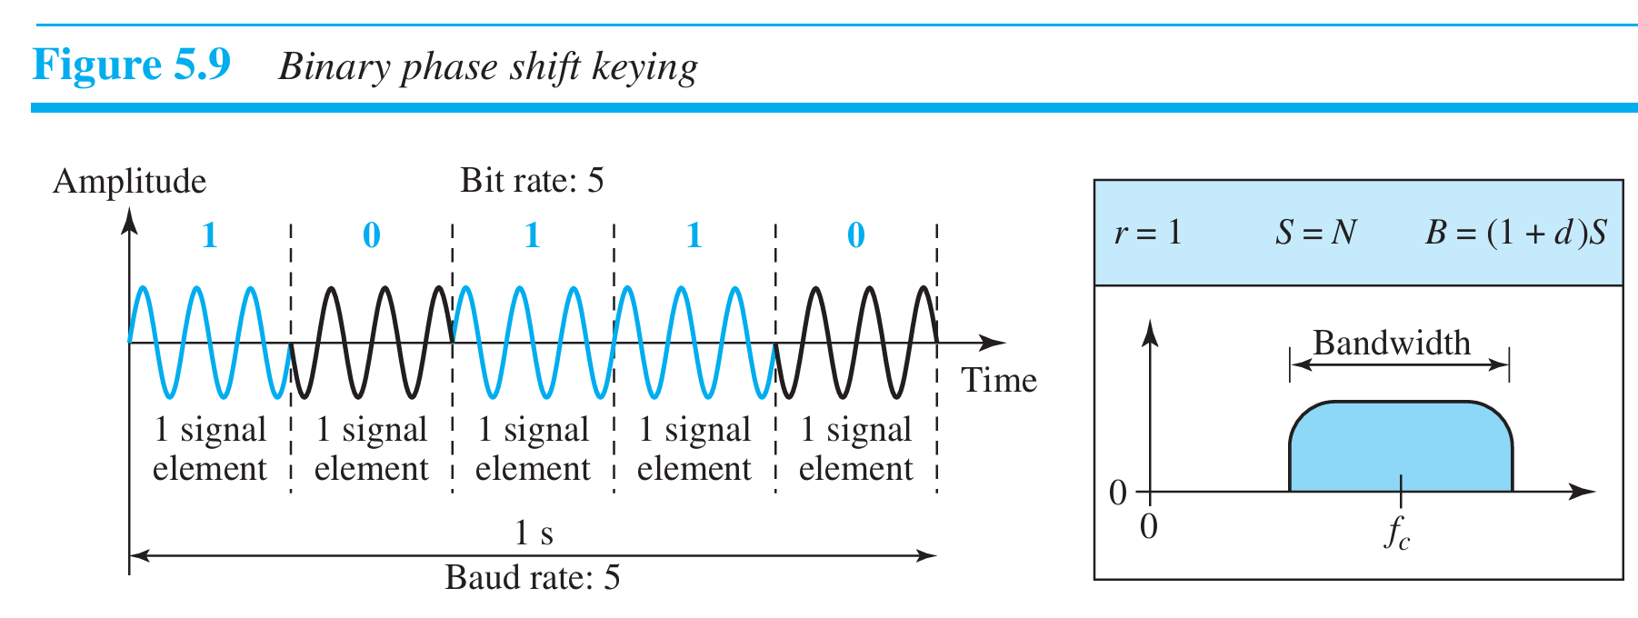

Slide 13
Calculate the baud rate for the given bit rate and type of modulation.
a. 2000 bps, FSK

Slide 14
Calculate the baud rate for the given bit rate and type of modulation.
a. 2000 bps, FSK
2000 baud

Slide 15
Calculate the bit rate for the given baud rate and type of modulation.
b. 1000 baud, ASK

Slide 16
Calculate the bit rate for the given baud rate and type of modulation.
b. 1000 baud, ASK
1000 bps

Slide 17
What is the number of bits per baud for the following techniques?
a. ASK with four different amplitudes
b. FSK with eight different frequencies
c. PSK with four different phases

Slide 18
The value of r in analog transmission is
r = log₂ L, where L is the number of different signal elements.
a. ASK with four different amplitudes → 2 bits per baud
b. FSK with eight different frequencies → 3 bits per baud
c. PSK with four different phases → 2 bits per baud

Slide 19
Agenda
Multiplexing techniques:
  Frequency-division multiplexing
  Wavelength-division multiplexing
  Time-division multiplexing

Slide 20
Bandwidth
Today’s technology includes high-bandwidth media such as optical fiber and satellite microwaves.
Each has a bandwidth far in excess of that needed for the average transmission signal.
If the bandwidth of a link is greater than the bandwidth needs of the devices connected to it, the bandwidth is wasted.
An efficient system maximizes the utilization of all resources; bandwidth is one of the most precious resources we have in data communications.

Slide 21
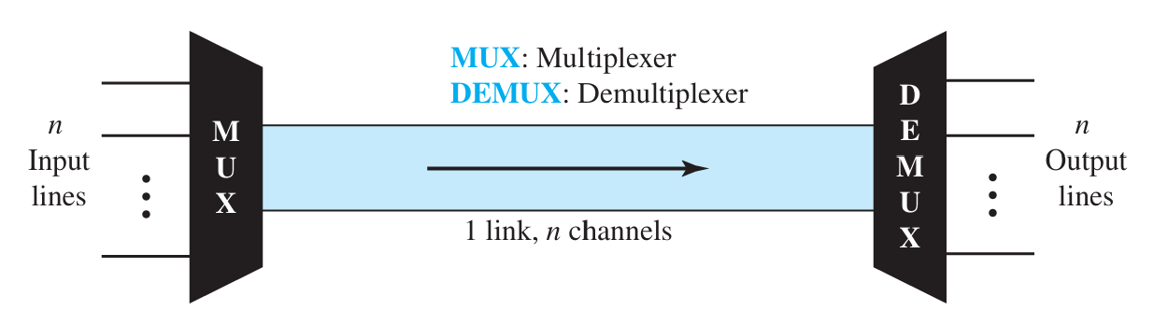
MULTIPLEXING
Whenever the bandwidth of a medium linking two devices is greater than the band width needs of the devices, the link can be shared.
Multiplexing is the set of techniques that allow the simultaneous transmission of multiple signals across a single data link.

Slide 22
MULTIPLEXING
In a multiplexed system, n lines share the bandwidth of one link.
The lines on the left direct their transmission streams to a multiplexer (MUX), which combines them into a single stream (many-to one).
At the receiving end, that stream is fed into a demultiplexer (DEMUX), which separates the stream back into its component transmissions (one-to-many) and directs them to their corresponding lines.
The word link refers to the physical path.
The word channel refers to the portion of a link that carries a transmission between a given pair of lines.
One link can have many (n) channels.

Slide 23
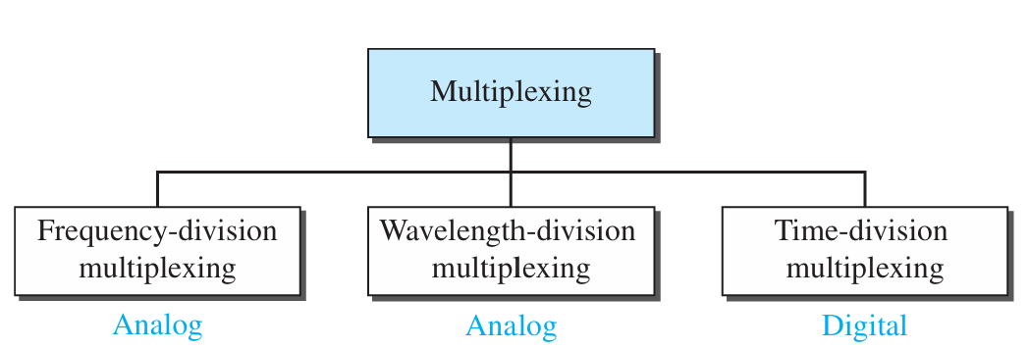
Multiplexing techniques
There are three basic multiplexing techniques: frequency-division multiplexing, wavelength-division multiplexing, and time-division multiplexing.
The first two are techniques designed for analog signals, the third, for digital signals

Slide 24
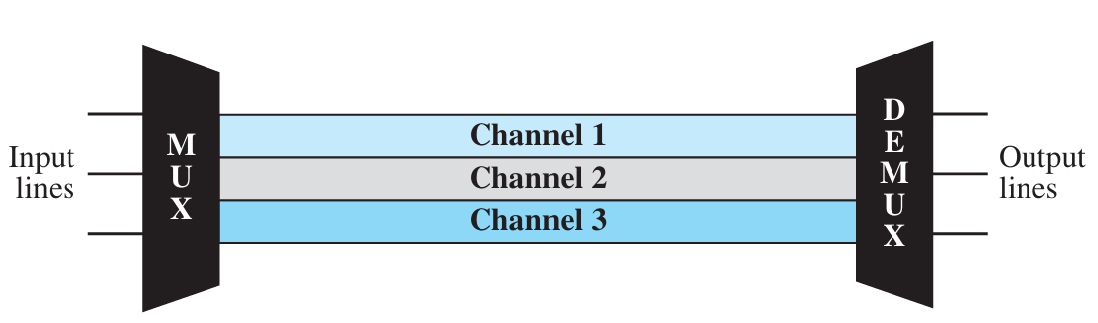
Frequency-Division Multiplexing (FDM)
FDM is an analog technique that can be applied when the bandwidth of a link (in hertz) is greater than the combined bandwidths of the signals to be transmitted.
In FDM, signals generated by each sending device modulate different carrier frequencies.
These modulated signals are then combined into a single composite signal that can be transported by the link.

Slide 25
Frequency-Division Multiplexing
Carrier frequencies are separated by sufficient bandwidth to accommodate the modulated signal.
These bandwidth ranges are the channels through which the various signals travel.
Channels can be separated by strips of unused bandwidth—guard bands—to prevent signals from overlapping.
In addition, carrier frequencies must not interfere with the original data frequencies.

Slide 26
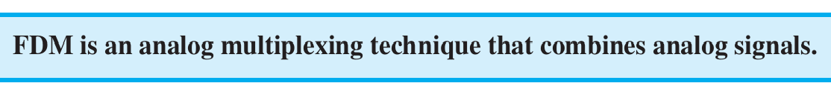
Frequency-Division Multiplexing
We consider FDM to be an analog multiplexing technique; however, this does not mean that FDM cannot be used to combine sources sending digital signals.
A digital signal can be converted to an analog signal (with the techniques discussed in Chapter 5) before FDM is used to multiplex them.

Slide 27
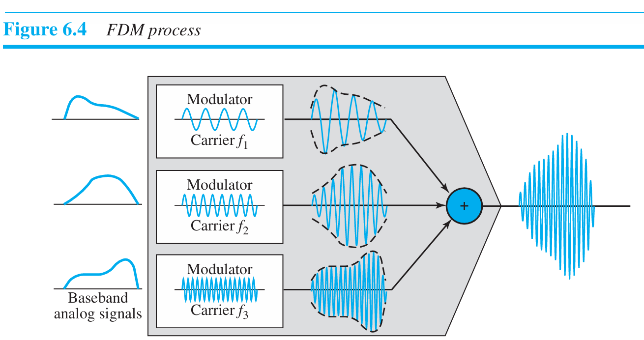
FDM Multiplexing Process
Each source generates a signal of a similar frequency range.
Inside the multiplexer, these similar signals modulates different carrier frequencies (f1, f2, and f3).
The resulting modulated signals are then combined into a single composite signal that is sent out over a media link that has enough bandwidth to accommodate it.

Slide 28
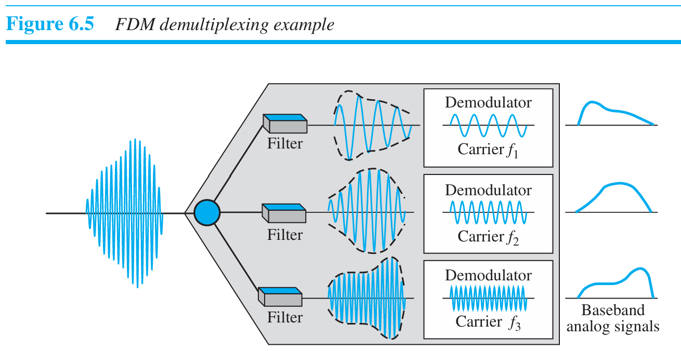
FDM Demultiplexing Process
The de-multiplexer uses a series of filters to decompose the multiplexed signal into its constituent component signals.
The individual signals are then passed to a demodulator that separates them from their carriers and passes them to the output lines.

Slide 29
Example
Assume that a voice channel occupies a bandwidth of 4 kHz.
We need to combine three voice channels into a link with a bandwidth of 12 kHz, from 20 to 32 kHz.
Show the configuration, using the frequency domain.
Assume there are no guard bands.

Slide 30
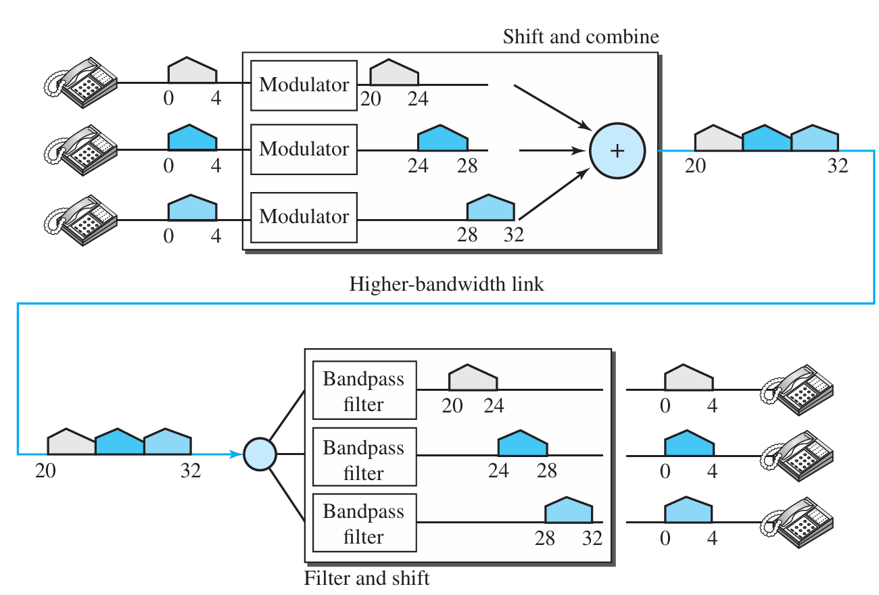
Solution

Slide 31
Example
Five channels, each with a 100-kHz bandwidth, are to be multiplexed together.
What is the minimum bandwidth of the link if there is a need for a guard band of 10 kHz between the channels to prevent interference?

Slide 32
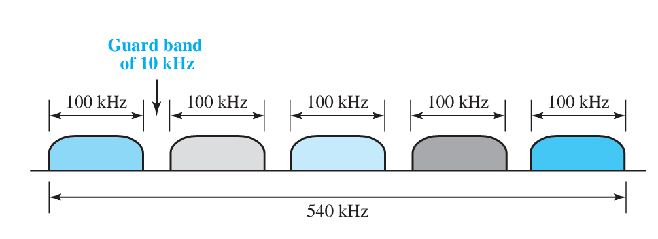
Solution
For five channels, we need at least four guard bands.
This means that the required bandwidth is at least
5 × 100 + 4 × 10 = 540 kHz

Slide 33
Example
Four data channels (digital), each transmitting at 1 Mbps, use a satellite channel of 1 MHz.
Design an appropriate configuration, using FDM.

Slide 34
Types of digital-to-analog conversion

Slide 35
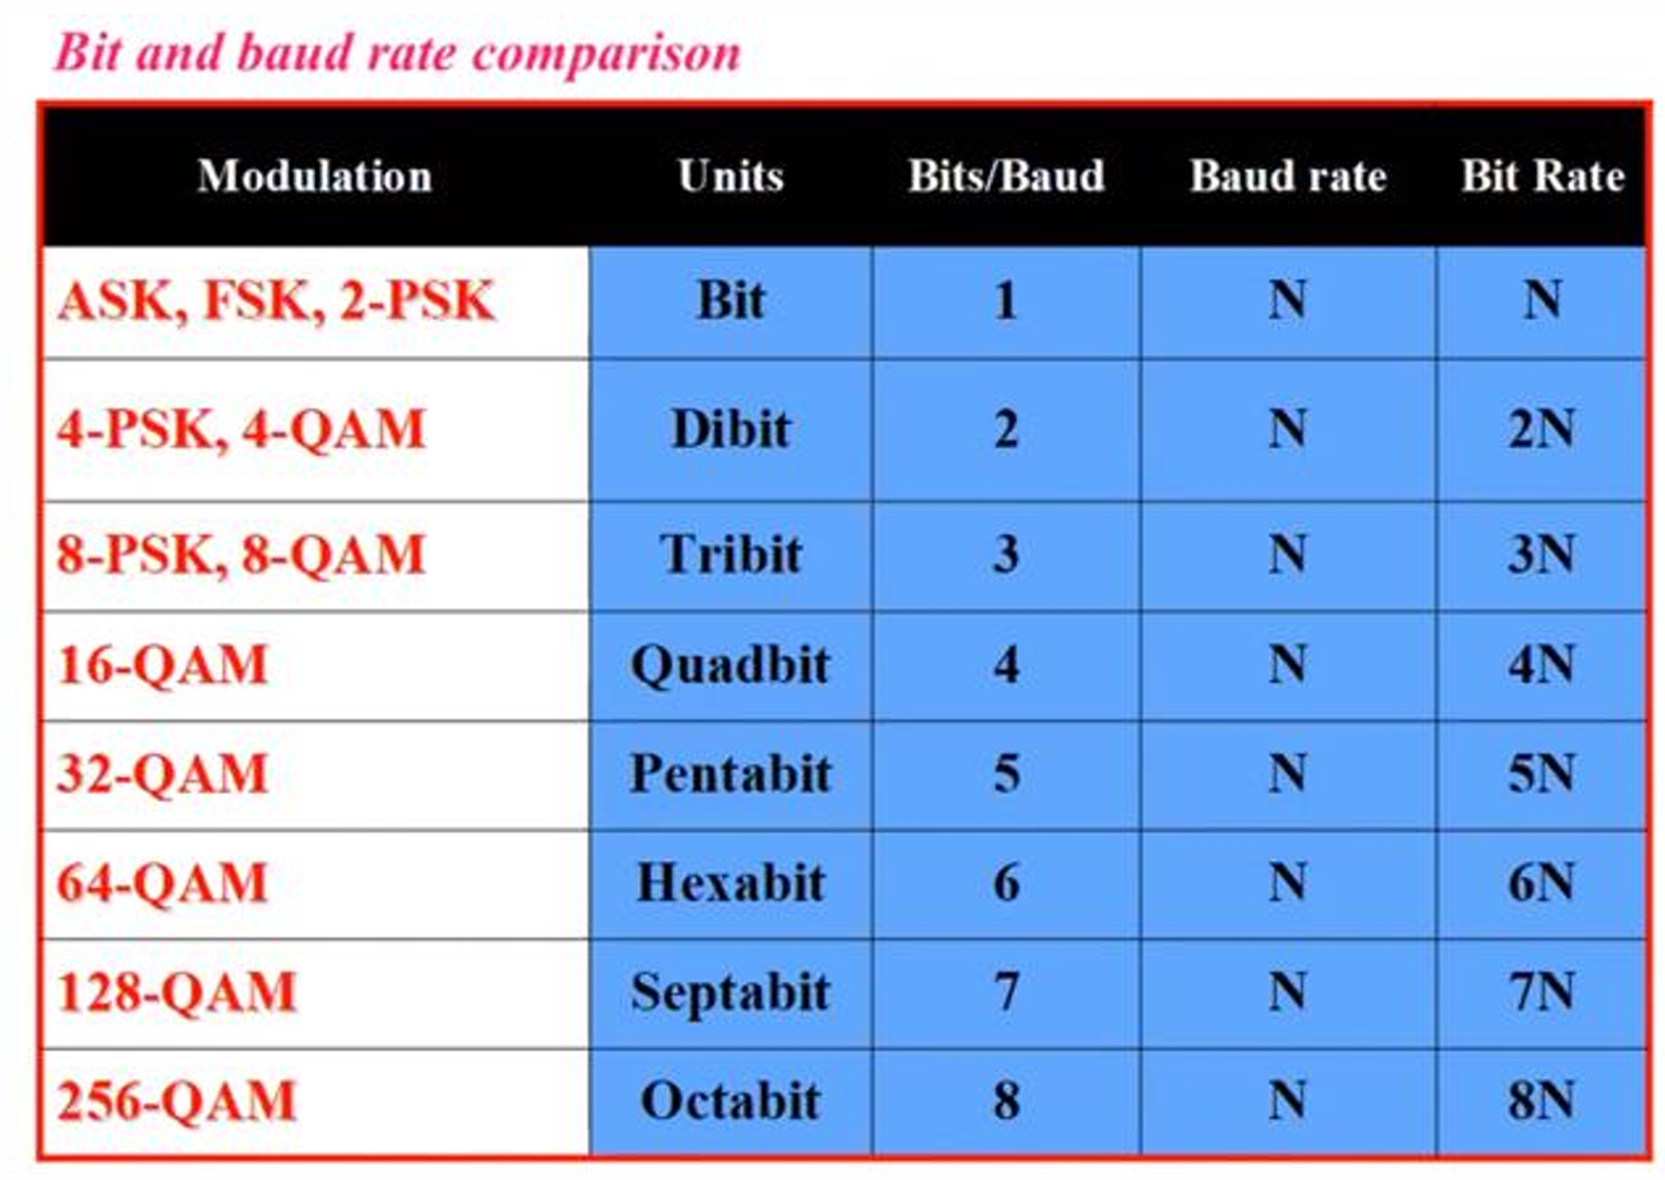

Slide 36
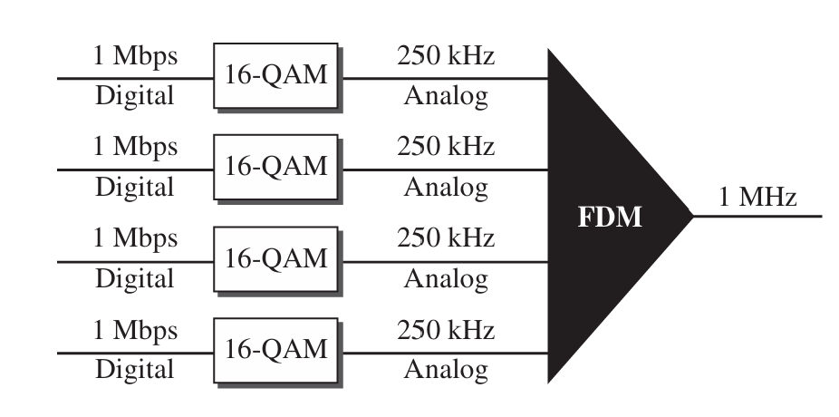
Solution
The satellite channel is analog.
We divide it into four channels, each channel having a 250-kHz bandwidth.
Each digital channel of 1 Mbps is modulated such that each 4 bits is modulated to 1Hz (i.e. 4*250=1000 kbps).
One solution is 16-QAM modulation. Figure shows one possible configuration

Slide 37
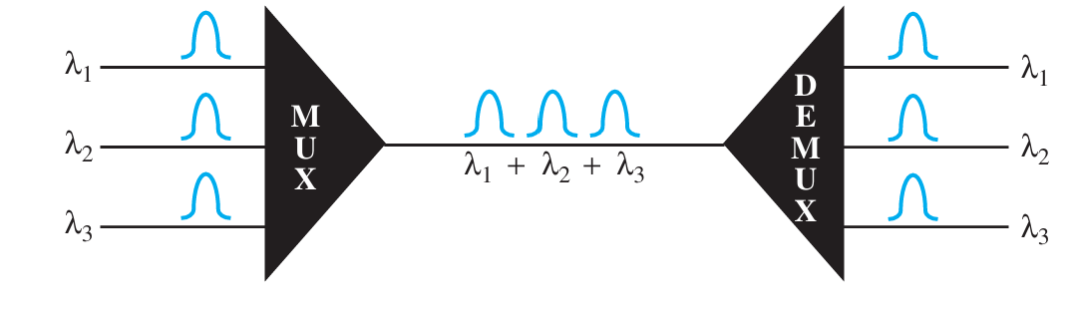
Wavelength-Division Multiplexing (WDM)
WDM is designed to use the high-data-rate capability of fiber-optic cable.
The optical fiber data rate is higher than the data rate of metallic transmission cable, but using a fiber-optic cable for a single line wastes the available bandwidth.
Multiplexing allows us to combine several lines into one.

Slide 38

Wavelength-Division Multiplexing
WDM is conceptually the same as FDM, except that the multiplexing and demultiplexing involve optical signals transmitted through fiber-optic channels.
The idea is the same: We are combining different signals of different frequencies.
The difference is that the frequencies are very high.

Slide 39
Time Division Multiplexing (TDM)
TDM is a digital process that allows several connections to share the high bandwidth of a link.
Instead of sharing a portion of the bandwidth as in FDM, time is shared.
Each connection occupies a portion of time in the link.

Slide 40
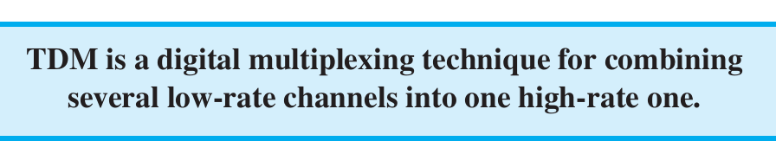
Time Division Multiplexing
TDM divides the time into fixed-size frames, with each frame consisting of a fixed number of time slots.
Each time slot can carry a portion of a separate signal.
Signals are interleaved in the frames in a repeating sequence.
TDM is a digital technique and requires signals to be converted to digital form before transmission.
We can divide TDM into two different schemes: synchronous and statistical.

Slide 41
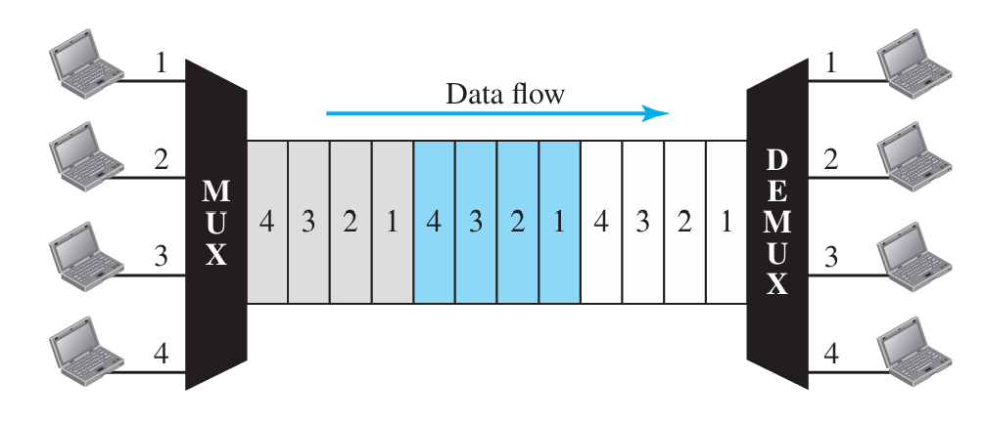
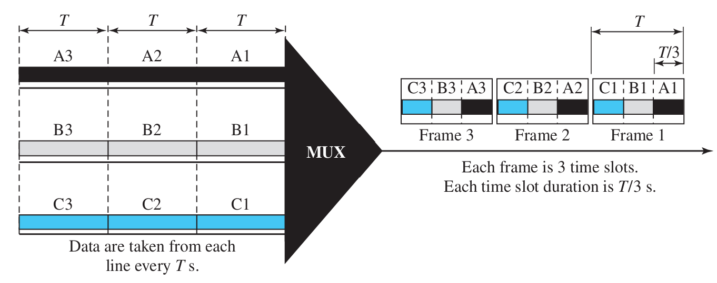
Time Division Multiplexing

Slide 42
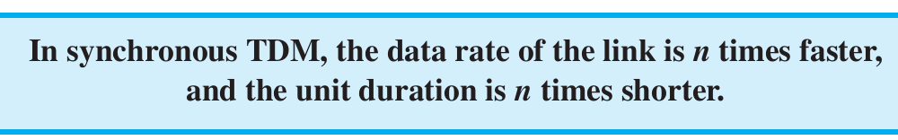
Synchronous TDM
If we have n connections, a frame is divided into n time slots and one slot is allocated for each unit, one for each input line.
If the duration of the input unit is T, the duration of each slot is T/n and the duration of each frame is T.

Slide 43
Example
In Figure below, the data rate for each input connection is 1 kbps. If 1 bit at a time is multiplexed (a unit is 1 bit),
what is the duration of
1. each input slot,
2. each output slot,
3. each frame?

Slide 44
Solution
We can answer the questions as follows:
The data rate of each input connection is 1 kbps. This means that the bit duration is 1/1000 s or 1 ms. The duration of the input time slot is 1 ms (same as bit duration).
The duration of each output time slot is one-third of the input time slot. This means that the duration of the output time slot is 1/3 ms.
Each frame carries three output time slots. So the duration of a frame is 3 × 1/3 ms, or 1 ms. The duration of a frame is the same as the duration of an input unit.

Slide 45
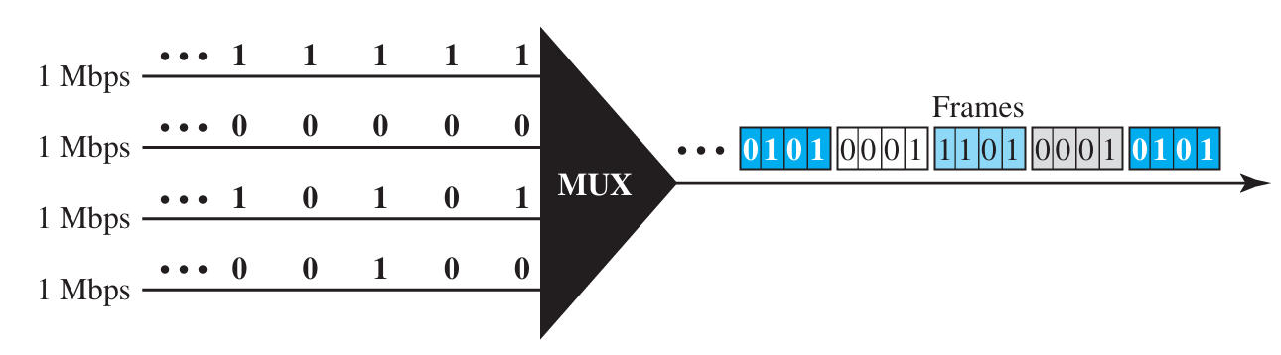
Example
In Figure below, synchronous TDM with a data stream for each input and one data stream for the output. The unit of data is 1 bit.
Find
(1) the input bit duration,
(2) the output bit duration,
(3) the output bit rate, and
(4) the output frame rate.

Slide 46
Solution
We can answer the questions as follows:
The input bit duration is the inverse of the bit rate: 1/1 Mbps = 1 (microsecond) μs.
The output bit duration is one-fourth of the input bit duration, or 1/4 μs.
The output bit rate is the inverse of the output bit duration, or 1/4 μs, or 4 Mbps. This can also be deduced from the fact that the output rate is 4 times as fast as any input rate; so the output rate = 4 × 1 Mbps = 4 Mbps.
The frame rate is always the same as any input rate. So the frame rate is 1,000,000 frames per second. Because we are sending 4 bits in each frame, we can verify the result of the previous question by multiplying the frame rate by the number of bits per frame.

Slide 47
Example
Four 1-kbps connections are multiplexed together. A unit is 1 bit.
Find
(1) the duration of 1 bit before multiplexing,
(2) the transmission rate of the link,
(3) the duration of a time slot, and
(4) the duration of a frame.

Slide 48
Solution
We can answer the questions as follows:
The duration of 1 bit before multiplexing is 1/1 kbps, or 0.001 s (1 ms).
The rate of the link is 4 times the rate of a connection, or 4 kbps.
The duration of each time slot is one-fourth of the duration of each bit before multiplexing, or 1/4 ms or 250 μs. Note that we can also calculate this from the data rate of the link, 4 kbps. The bit duration is the inverse of the data rate, or 1/4 kbps or 250 μs.
The duration of a frame is always the same as the duration of a unit before multiplexing, or 1 ms. We can also calculate this in another way. Each frame in this case has four time slots. So the duration of a frame is 4 times 250 μs, or 1 ms.

Slide 49
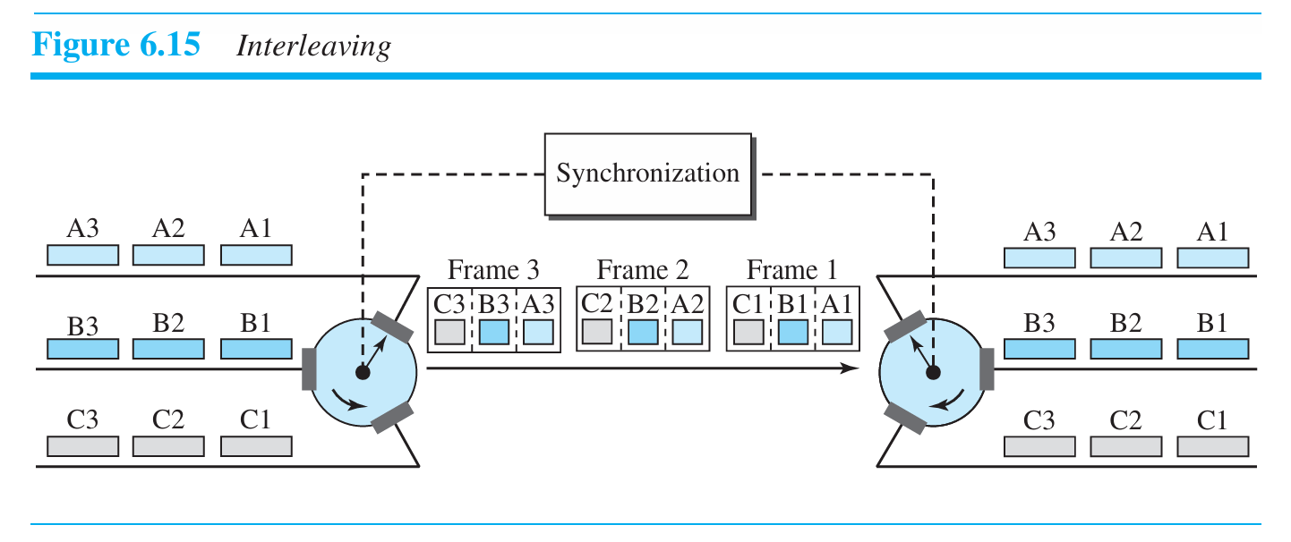
Interleaving

Slide 50
Example :
Four channels are multiplexed using TDM. If each channel sends 100 bytes/s and we multiplex 1 byte per channel, show:
A. the frame traveling on the link
B. the size of the frame
C. the duration of a frame
D. the frame rate
E. the bit rate for the link

Slide 51
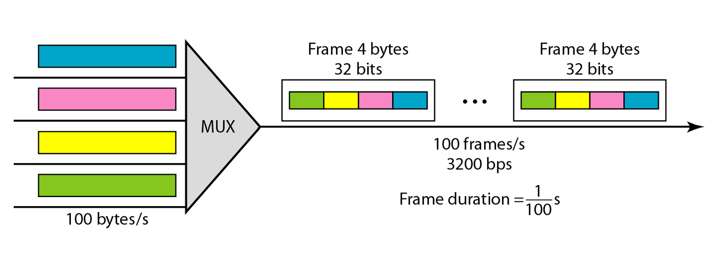
Solution
The multiplexer is shown in Figure 6.16.
Each frame carries 1 byte from each channel; the size of each frame, therefore, is 4 bytes, or 32 bits.
Because each channel is sending 100 bytes/s and a frame carries 1 byte from each channel, the frame rate must be 100 frames per second.
The bit rate is 100 × 32, or 3200 bps.

Slide 52
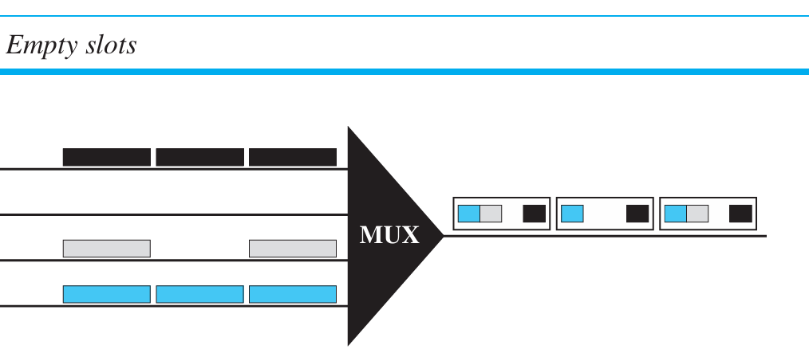
Empty Slots
If a source does not have data to send, the corresponding slot in the output frame is empty.

Slide 53
Data Rate Management
One problem with TDM is how to handle a disparity in the input data rates.
If data rates are not the same, three strategies, or a combination of them, can be used.
These three strategies to handle a disparity in the input data rates
  Multilevel multiplexing,
  Multiple-slot allocation
  Pulse stuffing

Slide 54
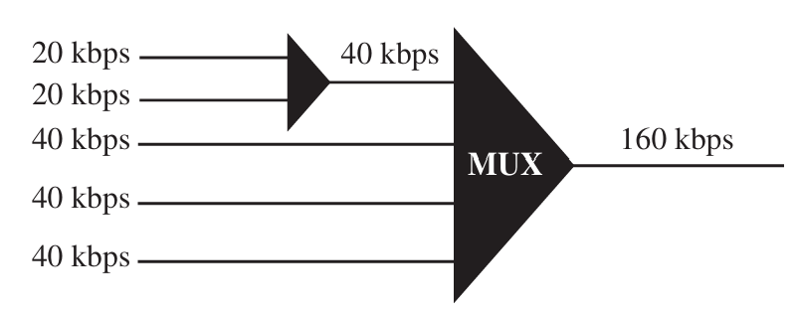
Multilevel multiplexing:
Technique used when the data rate of an input line is a multiple of others.
In Figure, we have two inputs of 20 kbps and three inputs of 40 kbps.
The first two input lines can multiplexed together to provide a data rate equal to the last three.
A second level of multiplexing can create an output of 160 kbps

Slide 55
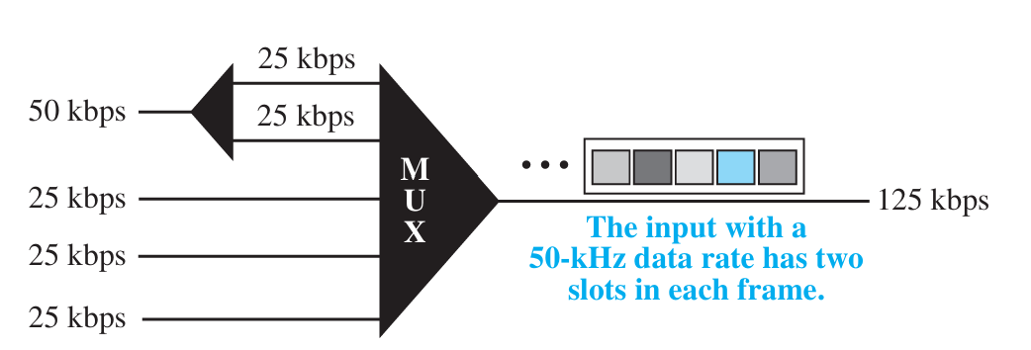
Multiple-slot allocation
It is more efficient to allocate more than one slot in a frame to a single input line.
For example, we might have an input line that has a data rate that is a multiple of another input.
In Figure , the input line with a 50-kbps data rate can be given two slots in the output.
We insert a serial-to-parallel converter in the line to make two inputs out of one.

Slide 56
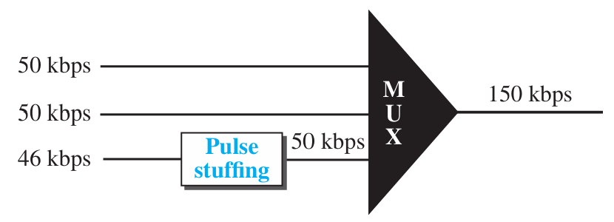
Pulse stuffing:
Sometimes the bit rates of sources are not multiple integers of each other.
One solution is to make the highest input data rate the dominant data rate and then add dummy bits to the input lines with lower rates.
This will increase their rates.
This technique is called pulse stuffing, bit padding, or bit stuffing. The idea is shown in Figure .

Slide 57
Exercises

Slide 58
True or False
Multiplexing can only be used for analog signals.
FDM is most commonly used in digital communication systems.
Guard bands in FDM help prevent interference between channels.

Slide 59
True or False
Multiplexing can only be used for analog signals.
FDM is most commonly used in digital communication systems.
Guard bands in FDM help prevent interference between channels.

Slide 60
In Time-Division Multiplexing (TDM), how is the resource shared?
  A) By dividing bandwidth.
  B) By dividing time.
  C) By dividing wavelengths.
  D) By dividing power.
Notes:
Answer: B

Slide 61
Which technique involves adding dummy bits to align input data rates in TDM?
  A) Multilevel multiplexing
  B) Pulse stuffing
  C) Guard band allocation
  D) Multiple-slot allocation
Notes:
Answer: B

Slide 62
What is the function of a demultiplexer in a multiplexing system?
  A) To combine signals into a composite stream.
  B) To allocate bandwidth among signals.
  C) To separate a multiplexed signal into individual streams.
  D) To amplify the signals for transmission.
Notes:
Answer: C

Slide 63
Practical

Slide 64
Project Title: Multiplexer Simulator
Objective:
Simulate the working of a Time-Division Multiplexing (TDM) system where multiple data streams from different sources are combined into a single data stream and then demultiplexed back to their respective channels.

Slide 65
Features:
Input:
  Allow users to input data streams for multiple channels (e.g., channel1: [1, 0, 1], channel2: [0, 1, 0]).
  Option to specify the number of channels and data units per channel.
Multiplexing:
  Combine the input streams into a single data stream using the TDM technique.
Demultiplexing:
  Split the combined data stream back into the original data streams.

